Slide 1

Telecom Users
Documentation

Slide 2
Table of Content
Slide 3 Overview
Slide4 Total Male Subscribers (which are not Senior Citizens). Displaying 5 columns
Slide5 Total Female Subscribers (which are not Senior Citizens). Displaying 5 columns
Slide6 Count Plot showing phone service and device protection for male non senior citizens
Slide7 Count Plot showing phone service and device protection for female non senior citizens
Slide8 Count Plot showing internet service and device protection details for non-senior citizens
Slide9 Count Plot showing streaming tv details for non-senior citizens
Slide10 Count Plot showing details of non-senior citizens who use or don't use paperless billing
Slide11 Count Plot showing details of non-senior citizens who use or don’t use device protection
Slide12 Heatmap showing correlation of numeric values
Slide13 Scatter Plot of Tenure and Total Charges
Slide14 Count plot of Senior Citizens and Non-Senior Citizens
Slide15 Count plot of Gender
Slide16 Cat plot of Payment Method by gender
Slide17 Cat plot of Contract Types
Slide18 Count plot of Online Security
Slide19 Count plot of Multiple Lines details
Slides 20&21 Conclusion and Recommendation

Slide 3

Overview
This document provides an in-depth analysis of telecom users and their subscription patterns across various products and packages.

Slide 4
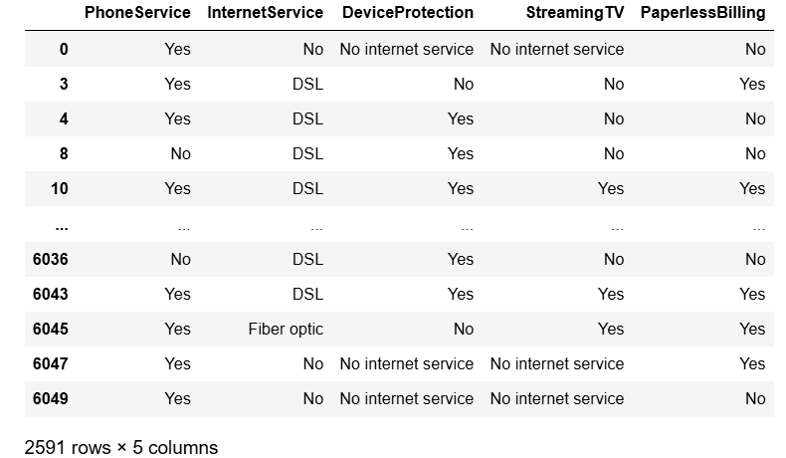
Total Male Subscribers (which are not Senior Citizens). Displaying 5 columns

Slide 5
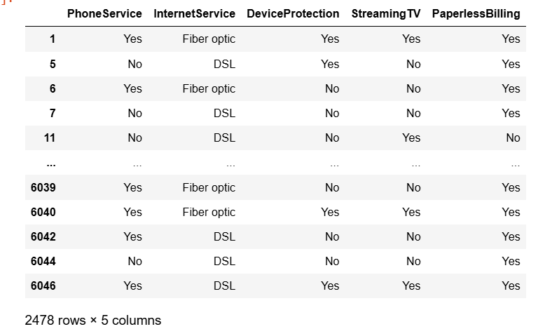
Total Female Subscribers (which are not Senior Citizens). Displaying 5 columns

Slide 6
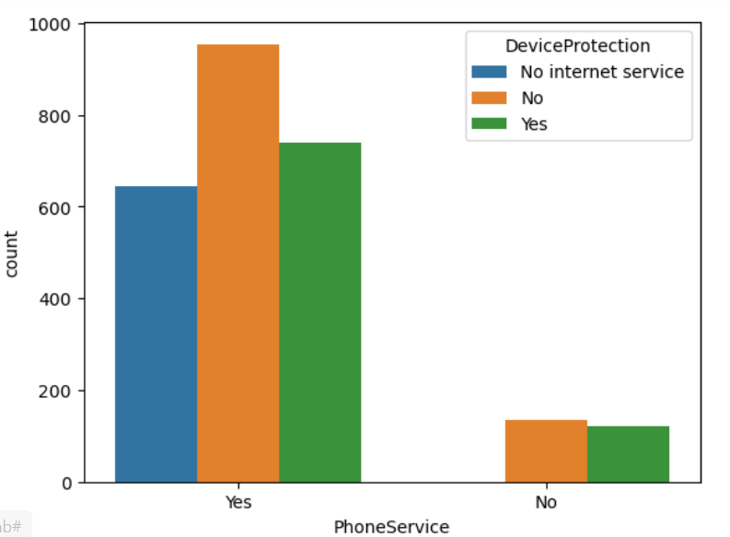
Countplot showing phone service and device protection for male non senior citizens

Slide 7
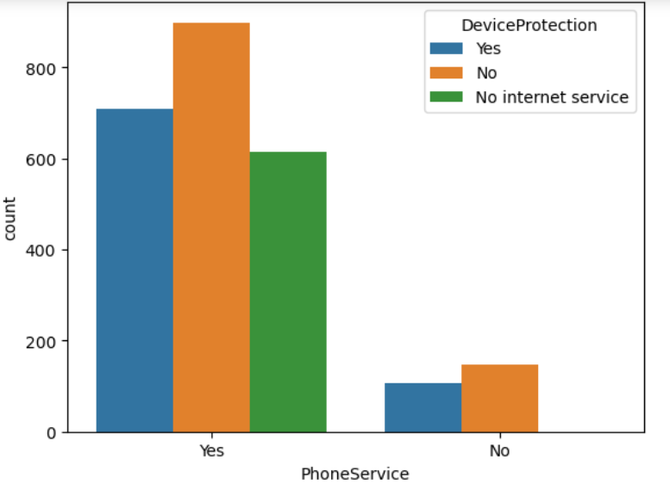
Countplot showing phone service and device protection for female non senior citizens

Slide 8
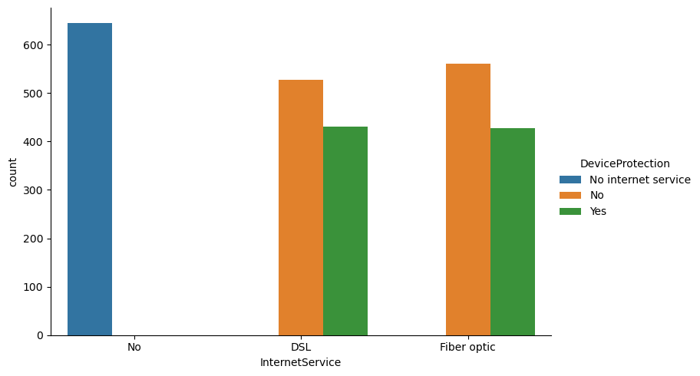
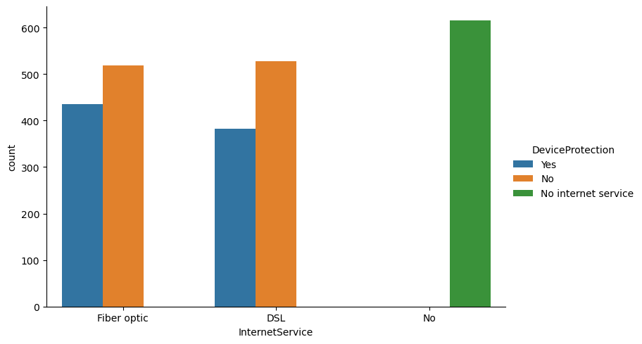
Countplot showing internet service and device protection details for non senior citizens
Male
Female

Slide 9
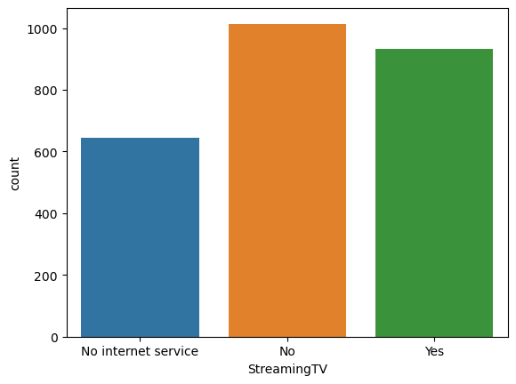
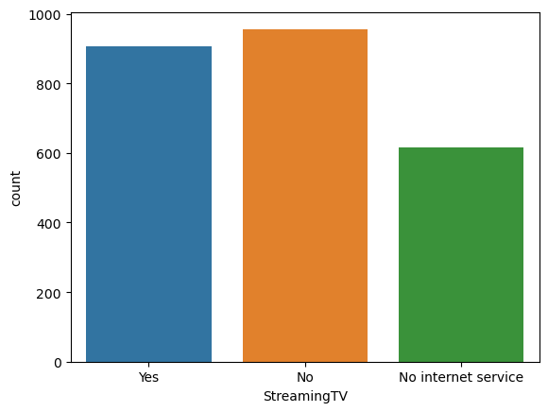
countplot showing streaming tv details for non senior citizens
Male
Female

Slide 10
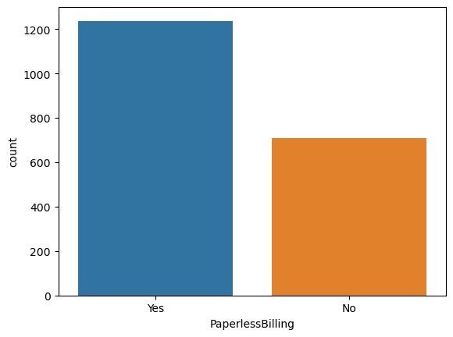
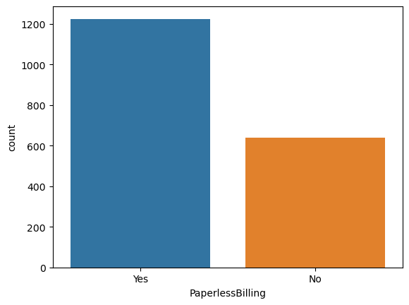
Countplot showing details of non-senior citizens who use or don't use paperless billing
Male
Female

Slide 11
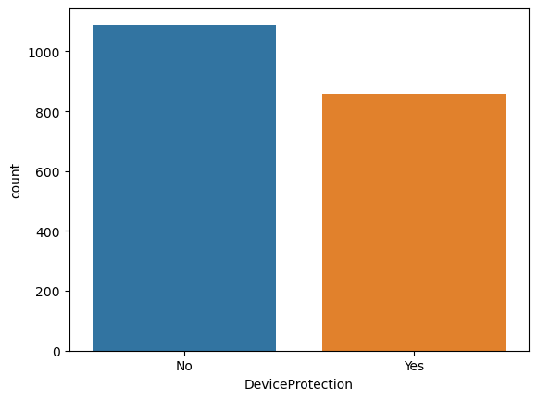
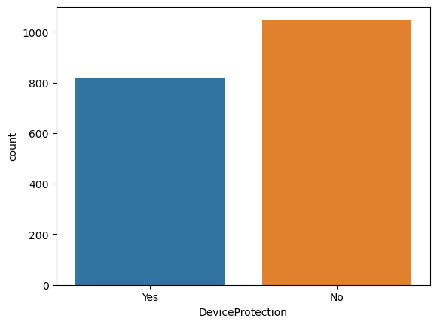
Countplot showing details of non-senior citizens who use or don’t use device protection
Male
Female

Slide 12
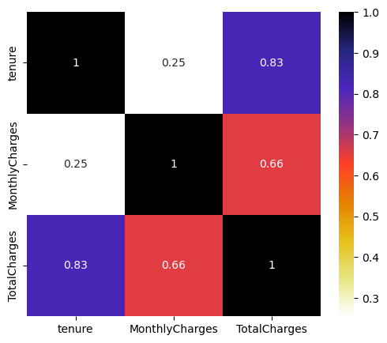
Heatmap showing correlation of numeric values

Slide 13
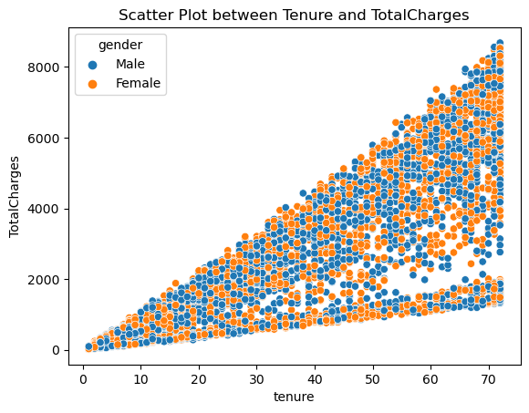
Scatter Plot of Tenure and Total Charges

Slide 14
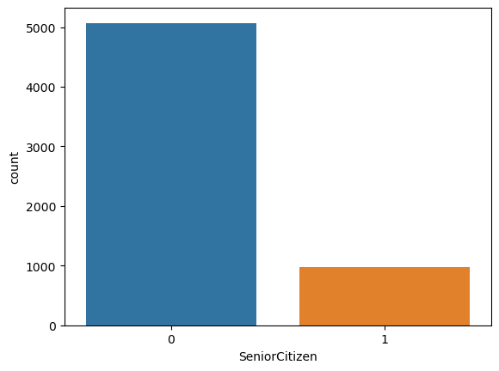
Count plot of Senior Citizens and Non Senior Citizens

Slide 15
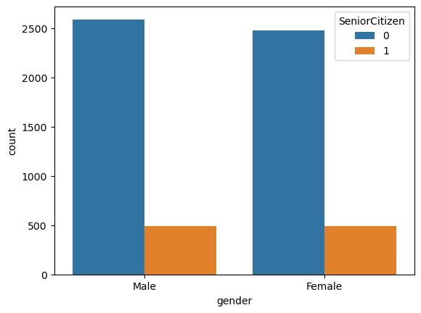
Count plot of Gender

Slide 16
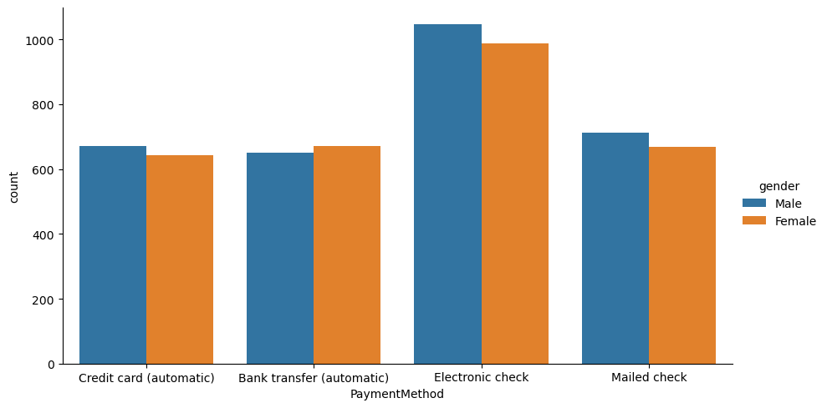
Catplot of Payment Method by gender

Slide 17
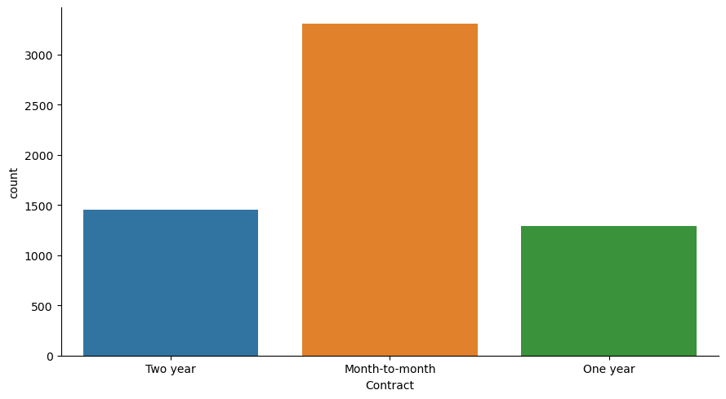
Catplot of Contract Types

Slide 18
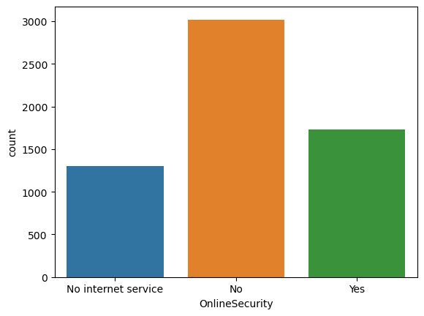
Countplot of Online Security

Slide 19
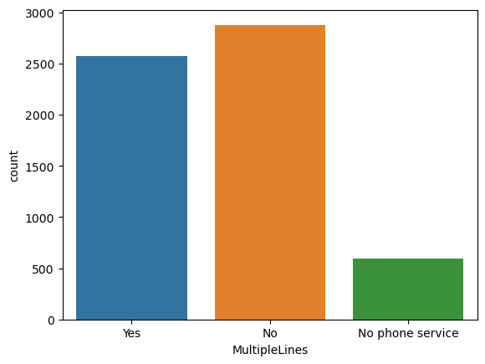
Countplot of Multiple Lines details

Slide 20
Conclusion and Recommendation
The distribution of genders among telecom users is relatively balanced, with a slightly higher number of male users at 3,081 and a little lower female users at 2,969.
Majority of telecom users are not senior citizens with only 16 percent of the users being senior citizens. The company should offer a range of services and support options that cater to the full spectrum of the customer base, from tech-savvy younger adults to senior citizens who may prefer traditional methods. Additional support and resources should be provided for senior citizens to ensure they can easily navigate and use products and services.
Most customers have opted for phone service, indicating that phone connectivity remains an essential service for many. New features or improvements such as enhanced call quality, additional services, and competitive pricing should be introduced in phone services.
There is a strong adoption of Fiber Optic internet , which is preferred for its speed and reliability. DSL remains a significant choice, balancing cost and performance, and serving areas where Fiber Optic is not available. Strategies should be developed to provide affordable internet solutions to underserved areas.
Customers should be educated on the benefits of streaming TV and how to set it up, addressing any barriers to adoption. The telecom company should partner with popular streaming platforms to offer exclusive content or discounts to entice customers to switch to or add streaming TV services.

Slide 21
Conclusion and Recommendation Continued..
A larger portion of customers prefer paperless billing, while a smaller yet substantial group opts for traditional paper billing. Paperless billing is convenient and cost-effective; benefiting both customers and the company. Develop marketing campaigns that highlight the convenience, environmental benefits, and potential cost savings of paperless billing to encourage more customers to switch; while Providing continued support and options for customers who prefer paper billing, ensuring they feel valued and not pressured to switch if they are uncomfortable with digital methods.
Electronic check is the most popular method, followed by mailed check, indicating a mix of digital and traditional payment preferences among customers. Bank transfer and credit card are also popular, highlighting a trend towards automated payment solutions for convenience and reliability. Provide information and support to help customers transition from mailed checks to more convenient payment methods. The security and ease of use of digital payment methods should be improved to increase adoption.
There is a roughly balanced distribution between customers with single lines (2,877) and those with multiple lines (2,575), highlighting diverse customer needs and preferences. The "No phone service" category (598) offers a potential market for the provider to explore, particularly through bundled service packages. Gather feedback to understand the reasons behind customers not opting for phone services or multiple lines, which can guide future service improvements and marketing strategies.
A significant number of customers (3,019) are without online security services, suggesting a potential area for service improvement or targeted marketing efforts. A notable portion (1,731) of customers has adopted online security services, reflecting awareness and the value placed on online protection. The "No" segment should be educated on the benefits of online security and the "No internet service" group should be targeted with attractive internet and security bundles.
When it comes to contract type, the data reflects varying preferences for flexibility and commitment among customers. The high number of month-to-month contracts indicates a strong preference for flexibility, while the substantial numbers for one-year and two-year contracts show a significant demand for stability and potential cost savings.

